Slide 1


Presentation on Mini Project
SereneSounds
A Sophisticated Music Curation Engine
Submitted by –
Name : Shib Kumar Saraf
Reg. No. : 22352239
MCA 2nd Year(3rd sem)
Pondicherry University
(Karaikal Campus)

Slide 2
Introduction
SereneSounds
Streamlit-based music recommendation web app offering diverse suggestions through lyric and musical similarity, collaborative filtering, ALS algorithm, and artist similarity using graph models.
Why It Is Needed?
What is Recommendation?
Effortless Music Discovery with Diverse Models.
Tailored Recommendations for Varied Tastes.
Dynamic Adaptation to Evolving Preferences.
Engaging User Experience with Refreshing Approaches.
Inclusive Accuracy through Combined Algorithms.
Recommendation is like a smart friend saying, "You might really like this!" based on what you've enjoyed before.

Slide 3
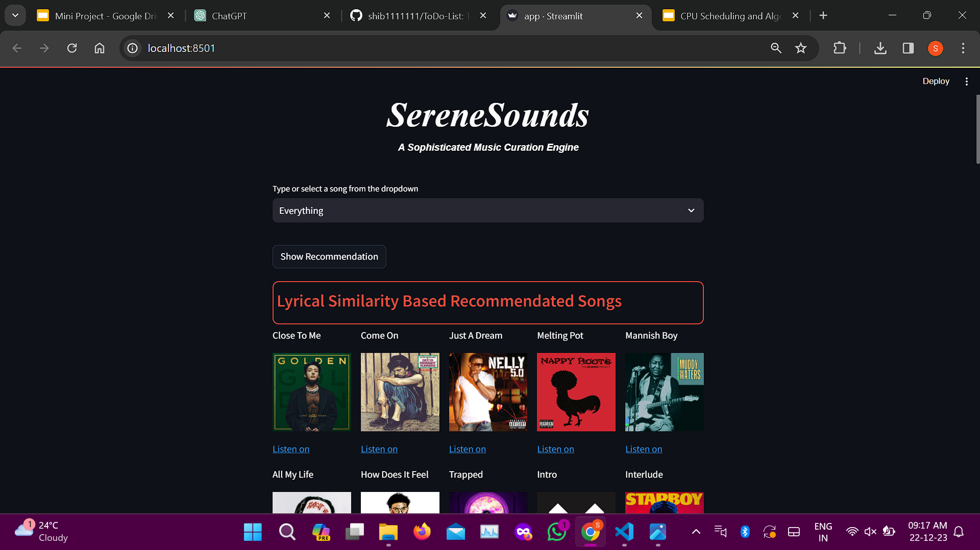
Web App

Slide 4
Data Flow Diagram
Raw Datasets
Data Preprocessing
Analysing
Use of Machine Learning or NLP Algos for Recommendations
Web app
Recommendation models to predict the various song based on user song input(song name)
User input for song(song name)
Show the top 10 or 20 recommended song based user input in HTML interface with clickable image
List of recommended song based user input and model prediction

Slide 5
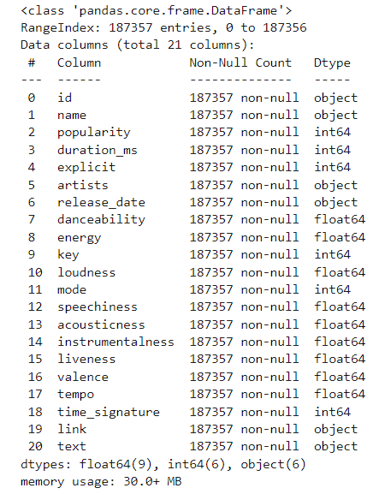
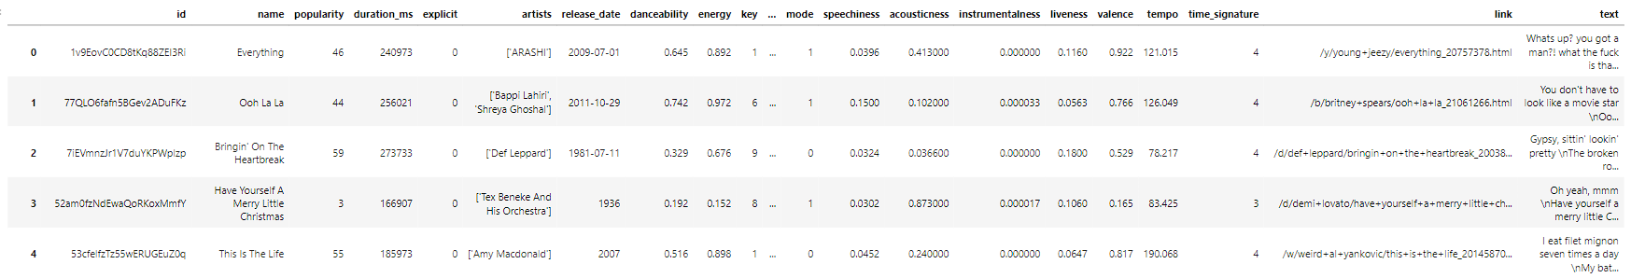
Raw Dataset
songs.csv
Sample data

Slide 6
Data Preprocessing
Data Preprocessing
Feature Engineering
Text Preprocessing
Tokenization
Data cleaning
Text Cleaning
Handling Missing Data
User Embedding Generation
Stopword Removal
Lemmatization and Stemming
Outlier Detection and Handling
Community Features
Graph Embedding
Encoding for supervised learning
Data Deduplication

Slide 7
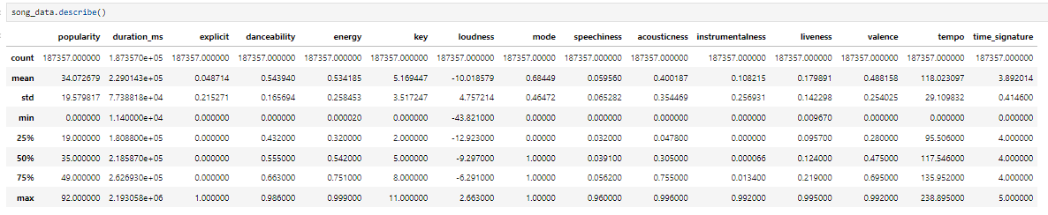
Data Analysing
Statistical Analysis

Slide 8
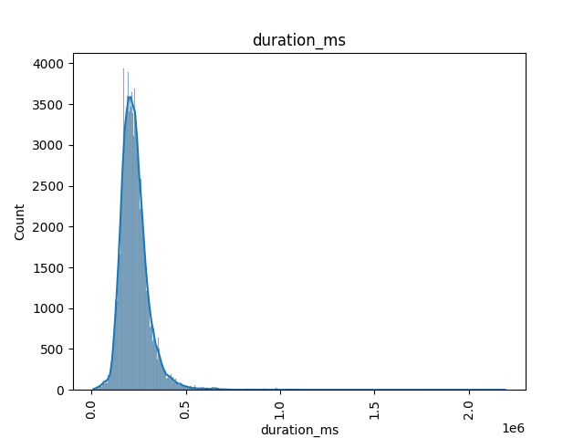
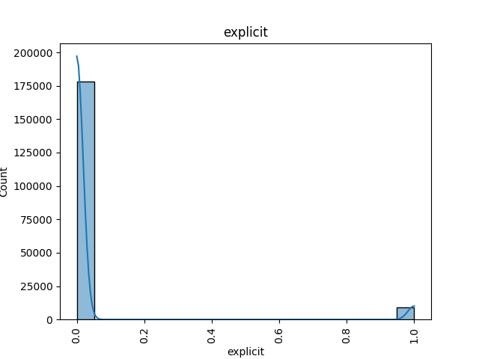
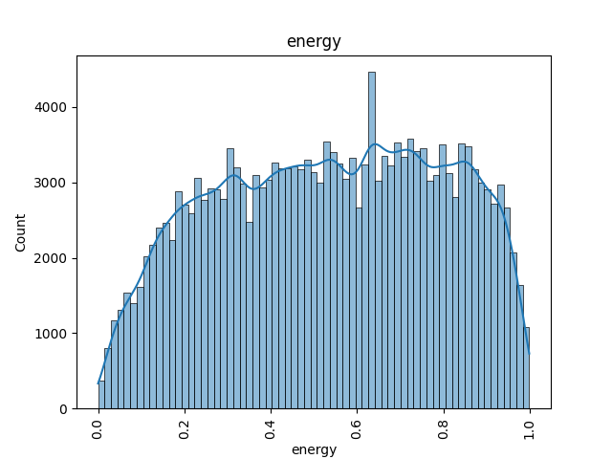
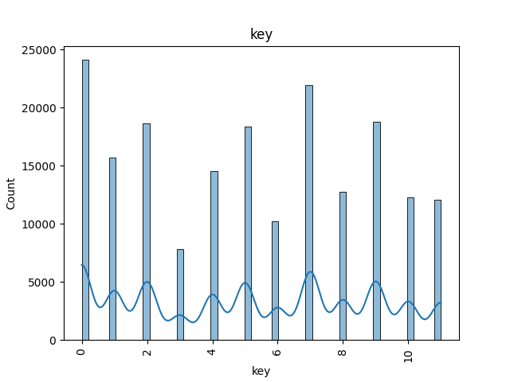
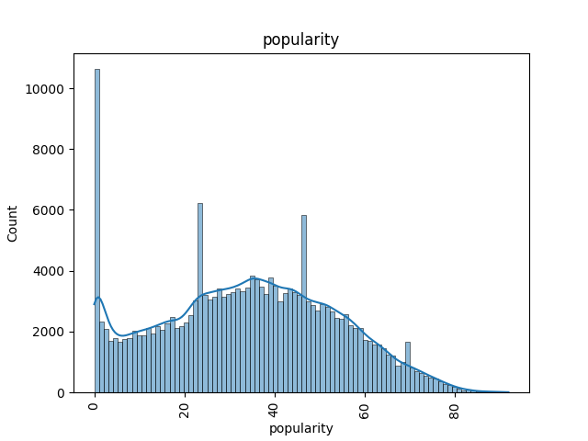
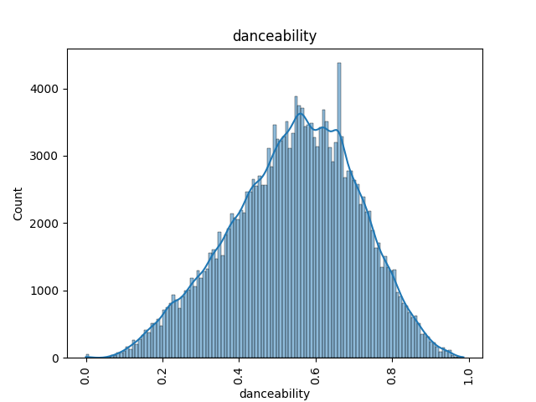
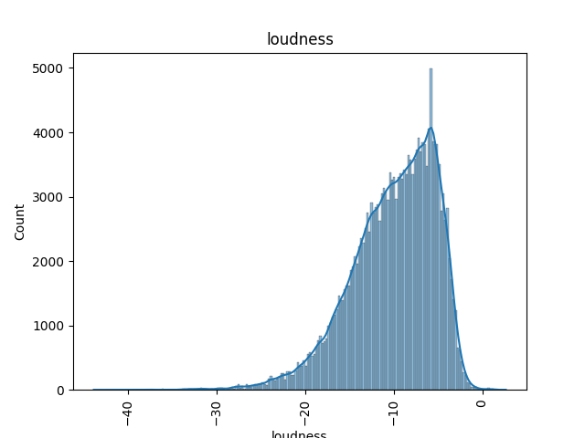
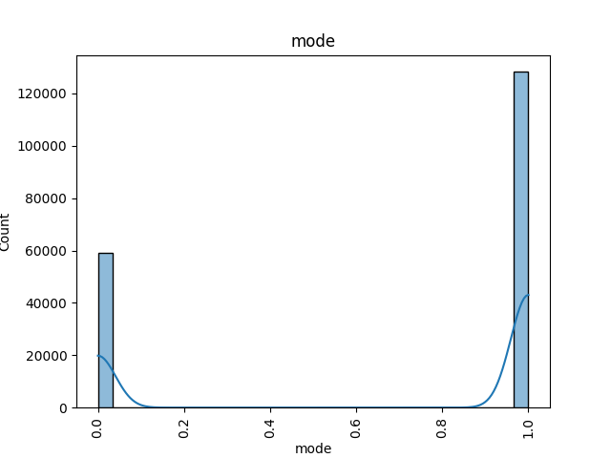
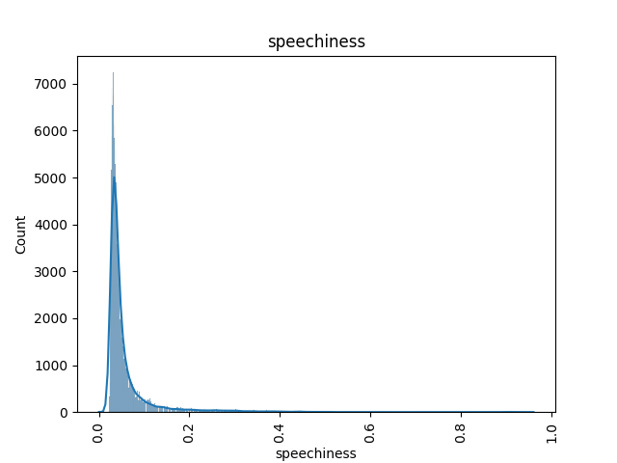
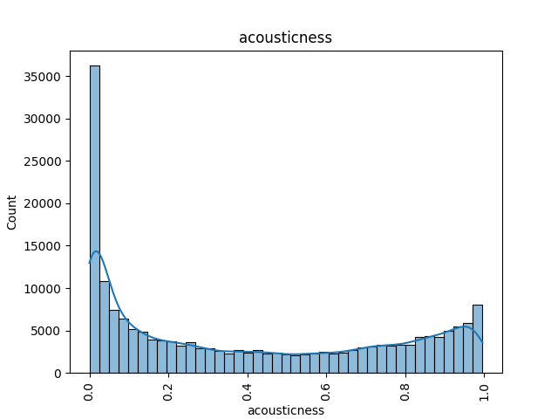
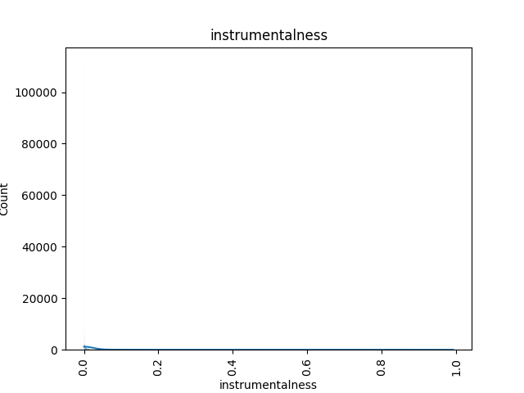
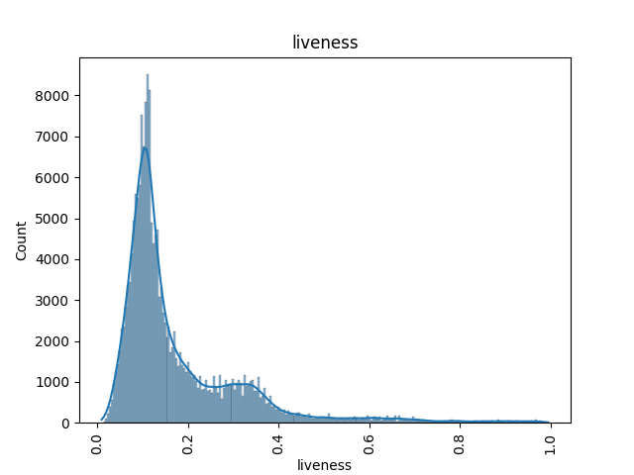
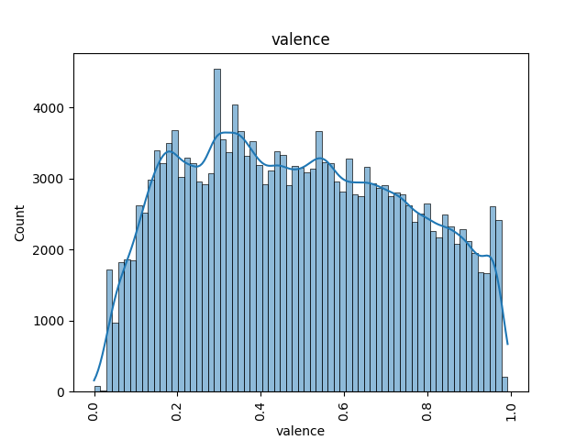
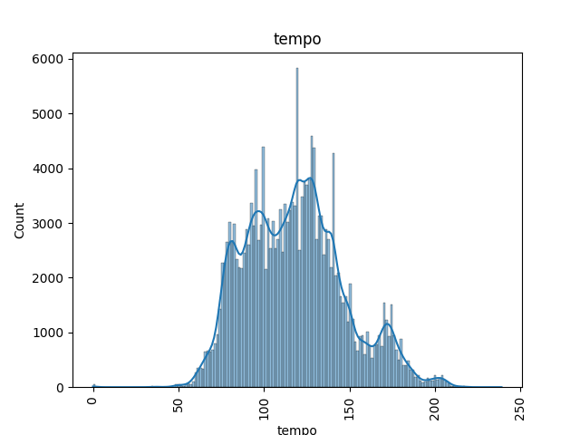
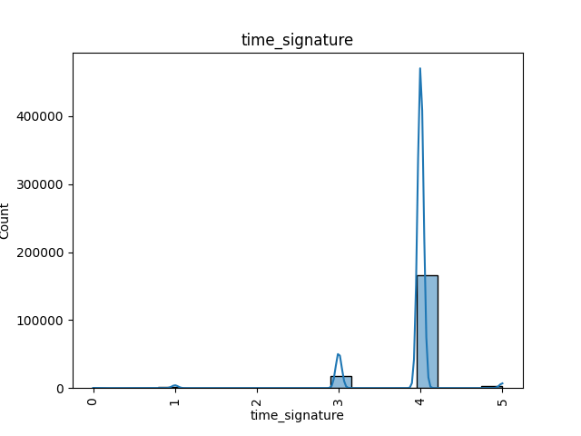
Data Analysing
Analysis the data of columns using Charts

Slide 9
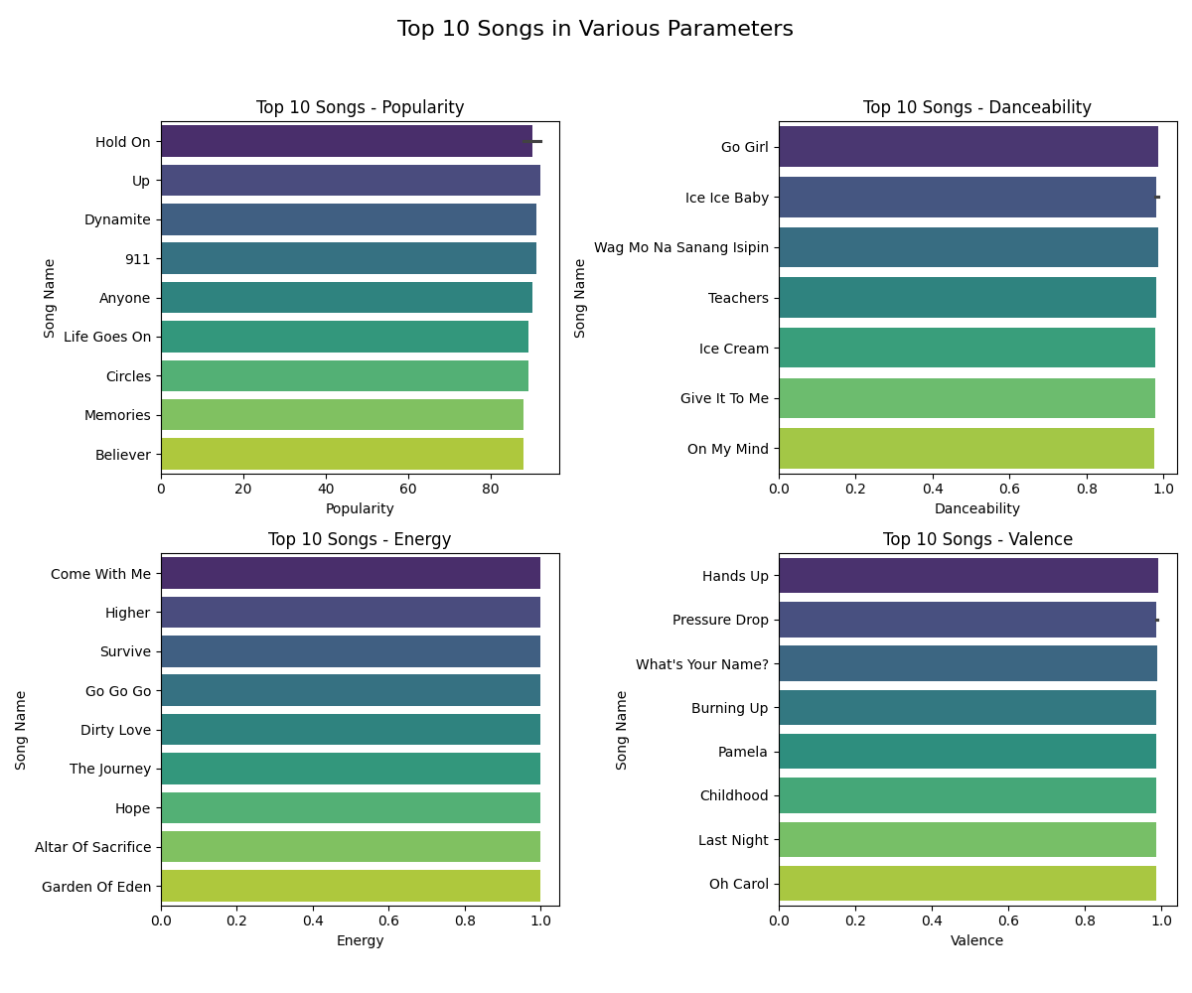
Data Analysing
Top 10 Songs in Various Parameters

Slide 10
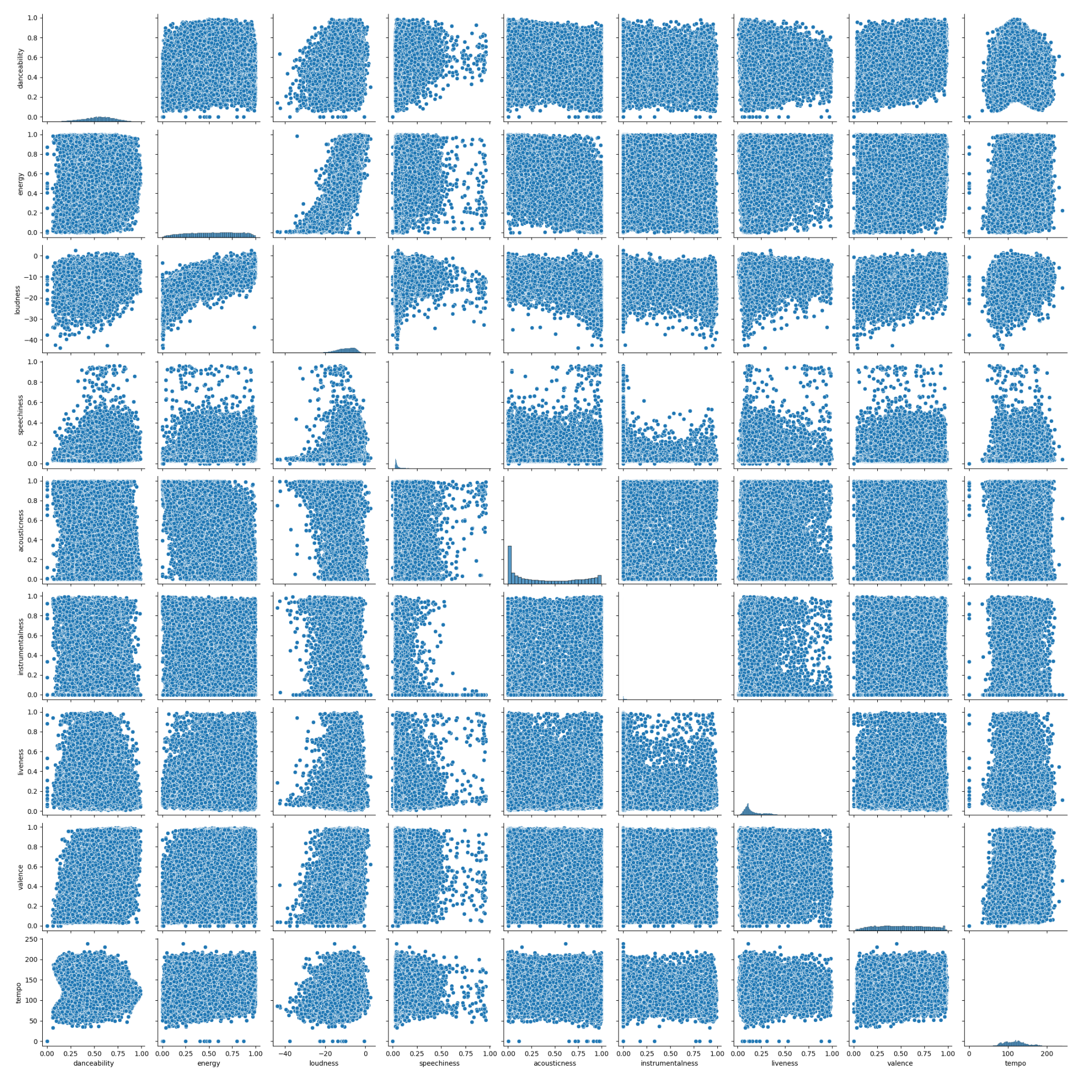
Data Analysing
Pairplots for Various Parameters

Slide 11
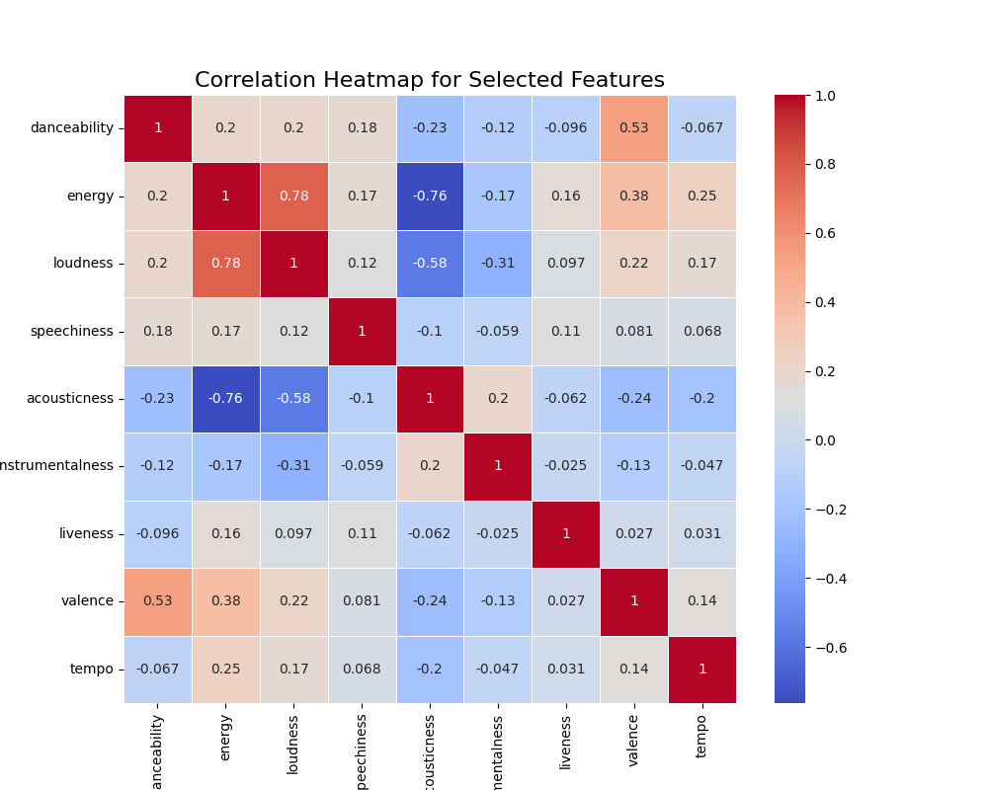
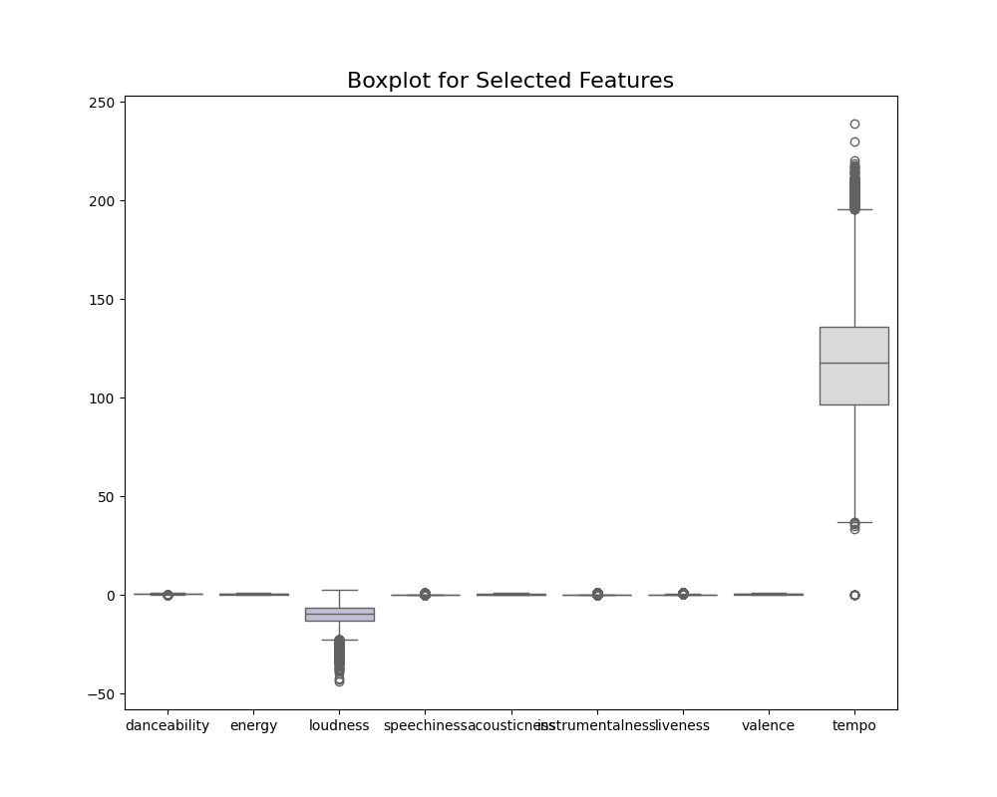
Data Analysing
Correlation Heatmap for Selected Features
Boxplot for Selected Features

Slide 12
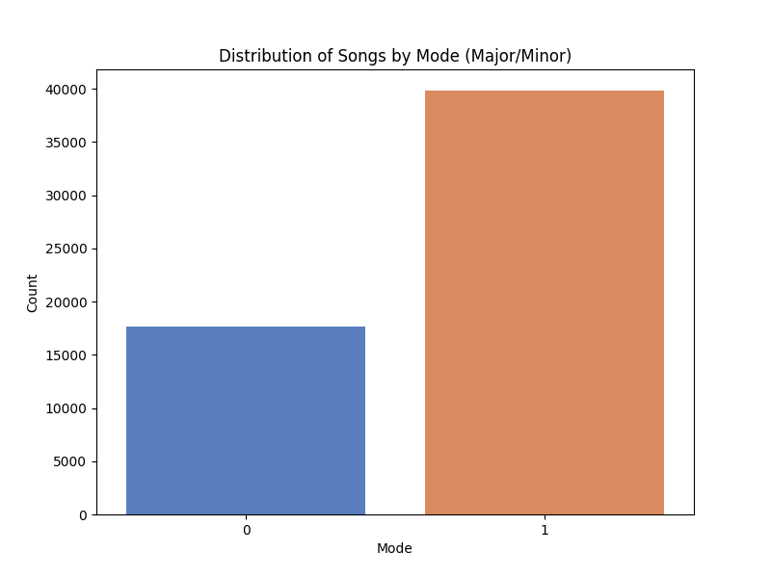
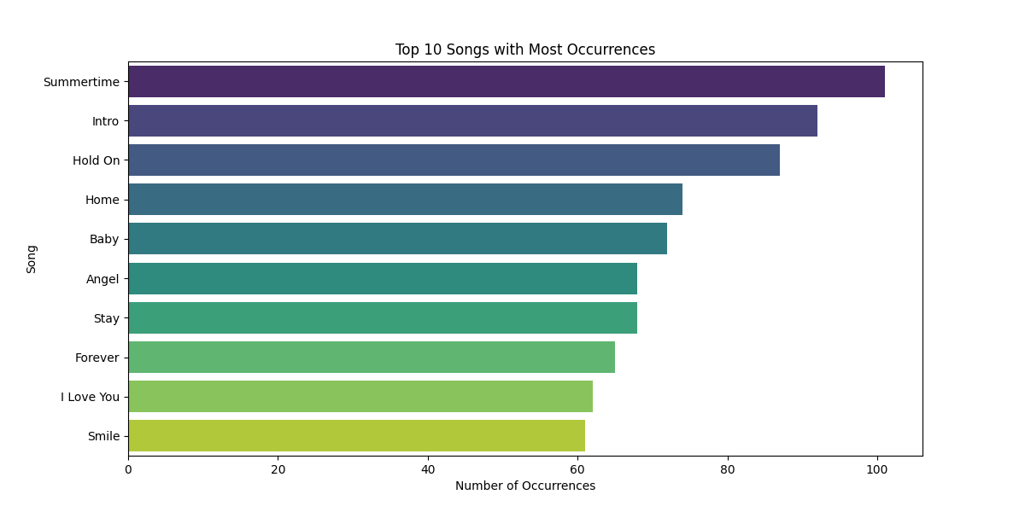
Data Analysing
Distribution of Songs by Mode (Major/Minor)
Top N Songs with Most Occurrences

Slide 13
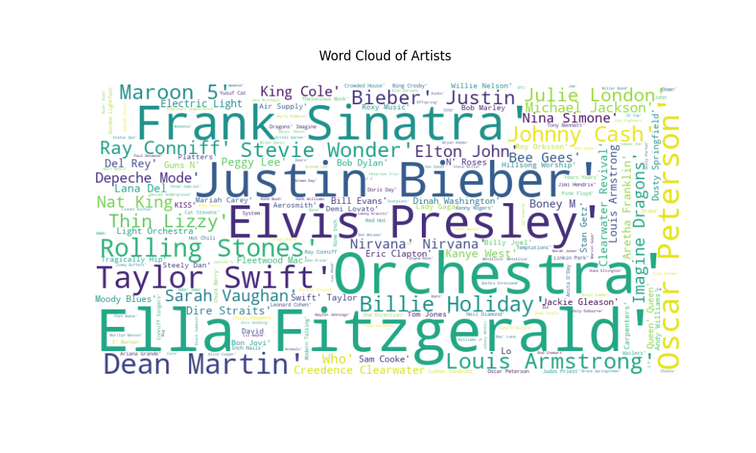
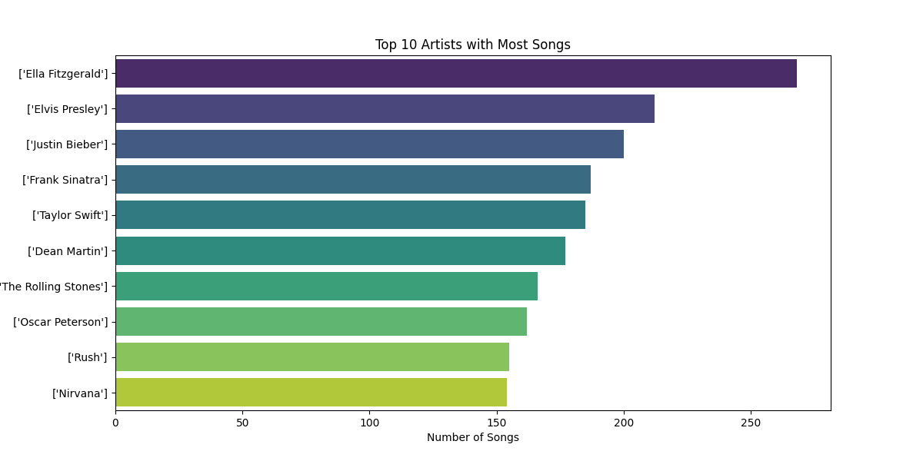
Data Analysing
Word Cloud for Song artists
Top N Artists with Most Songs

Slide 14
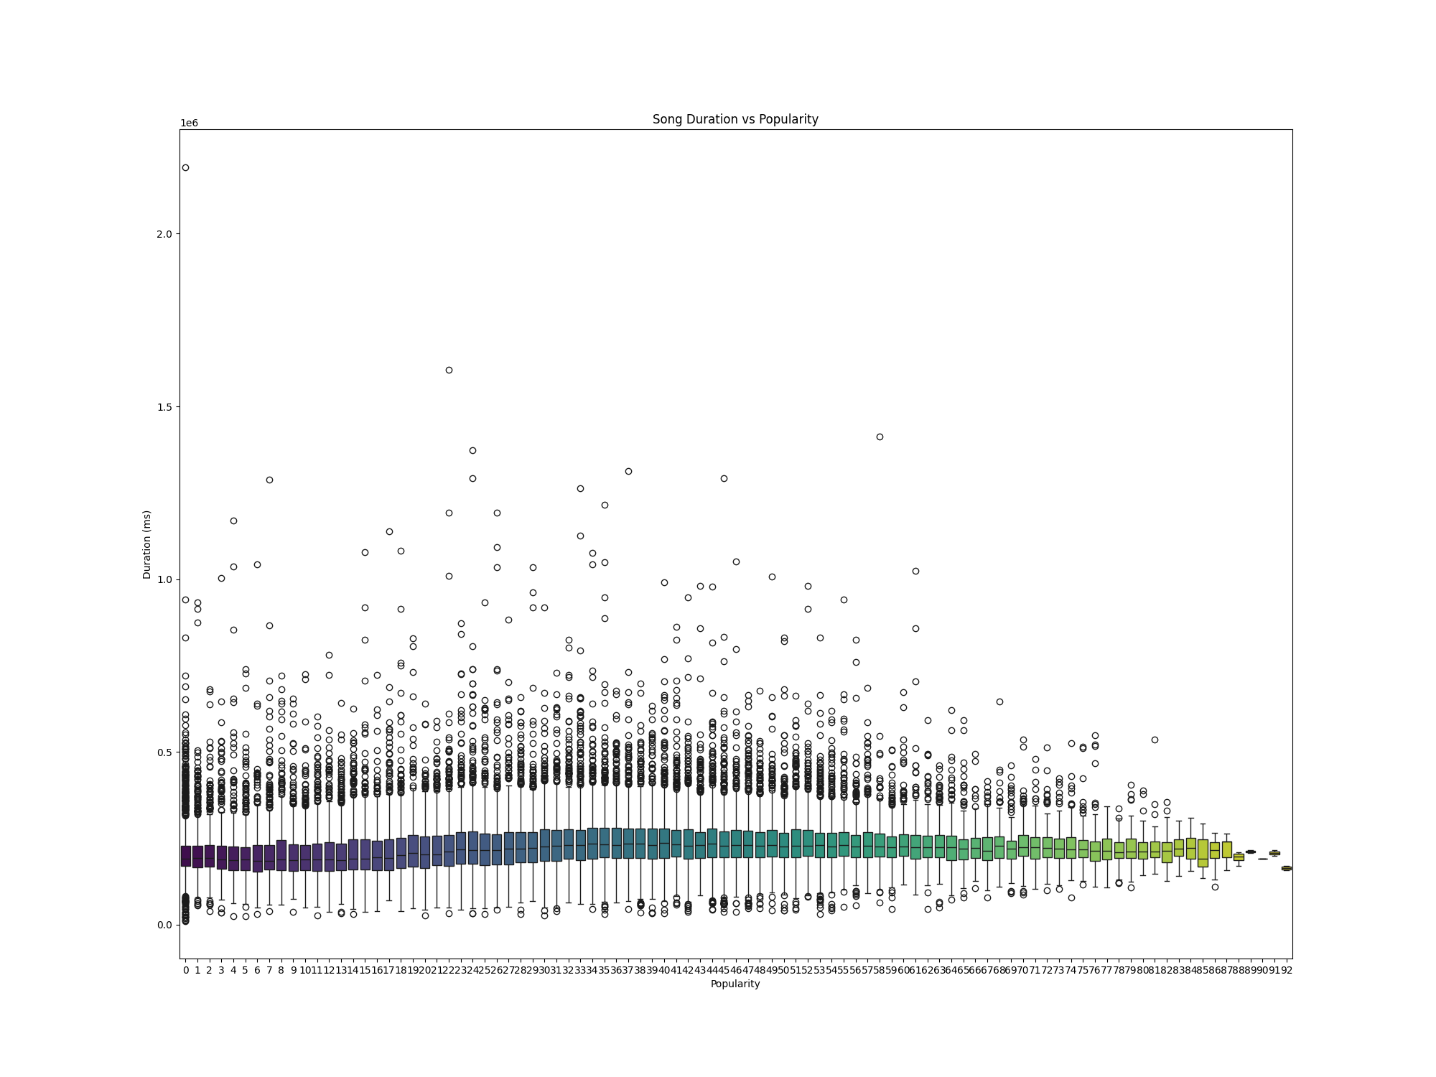
Data Analysing
Popularity Distribution

Slide 15
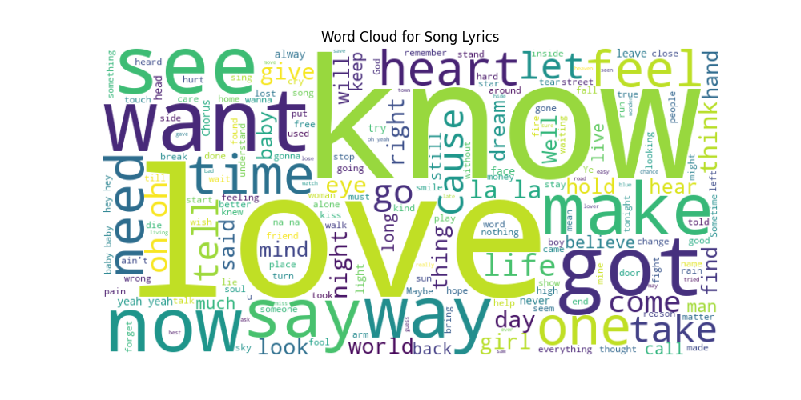
Data Analysing
Word Cloud for Song Lyrics (using a library like wordcloud)

Slide 16
Recommendation models
Use of Machine Learning or NLP for Recommendation
Alternating Least Squares Recommender
Lyrics Similarity Based Recommender
Collaborative Feature Based Recommender
Musical Feature Similarity Based Recommender
Artists Similarity Based Recommender (Graph Based)

Slide 17
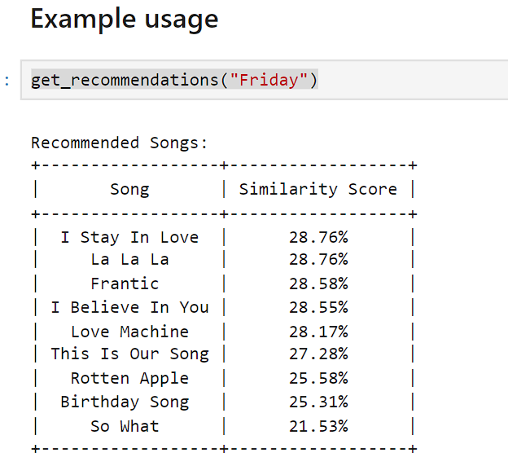
Lyrics Similarity Based Recommender
Data Preprocessing:
Text data is cleaned by converting to lowercase, removing non-alphanumeric characters, punctuation, and replacing newline characters.
Feature Engineering:
A 'tags' column is created by combining song names and preprocessed text.
Text Normalization:
Stemming, lemmatization, and stop word removal are applied to 'tags' for text normalization.
TF-IDF Vectorization:
TF-IDF: The product of Term Frequency (TF) and Inverse Document Frequency (IDF) it quantifies the importance of a term in the context of a specific document and the entire corpus. Words with high TF-IDF scores are often important in representing the content of a document.
Text is transformed into a TF-IDF matrix, capturing term importance in the corpus.
Recommendation System:
Cosine similarity is calculated from TF-IDF matrix , that is used to recommend songs similar to a given input, demonstrated with an example recommending songs similar to "Friday."

Slide 18
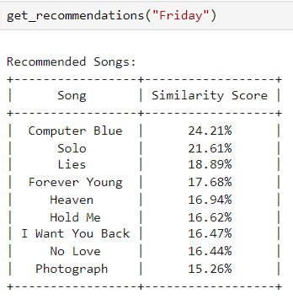
Musical Feature Similarity Based Recommender
Feature Concatenation:
Musical features such as 'danceability', 'energy', 'loudness', 'speechiness', 'acousticness', 'instrumentalness', 'liveness', 'valence', 'tempo’ are converted to strings and combined into a new column, 'features_str,' for each song in the dataset.
TF-IDF Vectorization:
The 'features_str' column undergoes TF-IDF vectorization, transforming the musical features into a matrix that captures their importance across songs.
Similarity Computation:
Cosine similarity is computed among songs based on their TF-IDF representations of musical features, quantifying the similarity between songs in the high-dimensional feature space.
Recommendation Function:
The code defines a function, get_recommendations, which utilizes the computed similarity scores to recommend songs that share musical feature patterns. The top 10 recommendations are displayed along with their respective similarity scores.

Slide 19
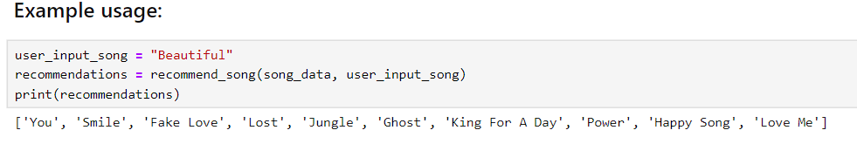
Collaborative Feature Similarity Based Recommender
Sorting:
The function sorts the song_data DataFrame based on popularity, time signature, duration, and explicitness in descending, ascending, ascending, and descending order, respectively.
User Song Filtering:
The user's provided song is filtered from the dataset. If the provided song is not in the dataset, a message is returned indicating so.
Criteria for Recommendation:
The function extracts attributes such as time signature, duration, and explicitness from the user's song.
It then filters songs with similar time signature, higher popularity, similar duration (within the median duration of the dataset), and opposite explicitness.
Exclusion of Redundant and Same-Name Songs:
Redundant and same-name songs are excluded from the recommendations.
Final Recommendation:
If there are suitable recommended songs, the function returns a list of up to 10 unique song names; otherwise, it returns a message indicating that no similar songs with higher popularity were found.

Slide 20
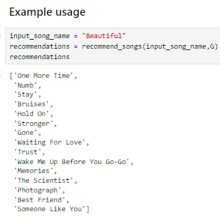
Artists Similarity Based Recommender (Graph Based)
Graph Construction:
A NetworkX graph (G) is created to represent artist collaborations.
For each song, the code iterates through the artists and creates edges between pairs of artists. The weight of each edge represents the number of collaborations between the artists.
Graph Serialization (Saving and Loading):
The graph (G) is serialized and saved to a pickle file named "graph_data.pkl."
Graph Deserialization:
The serialized graph is loaded back from the pickle file.
Recommendation Function:
The function recommend_songs takes an input song name, the graph, and an optional parameter for the number of recommendations.
It finds the artist(s) associated with the input song.
Identifies similar artists by exploring the graph and excluding the input song's artist(s).
Retrieves songs by the similar artists, excluding the input song.
Sorts the recommendations by popularity and selects the top ones.
Ensures uniqueness in the list of recommended song names.
Returns a list of unique recommended song names.

Slide 21
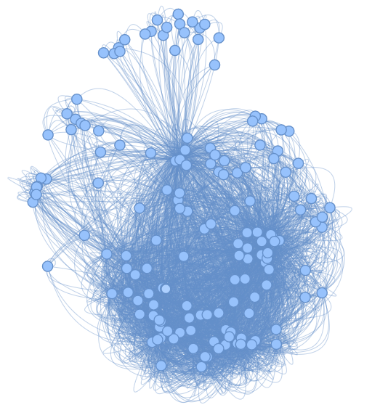
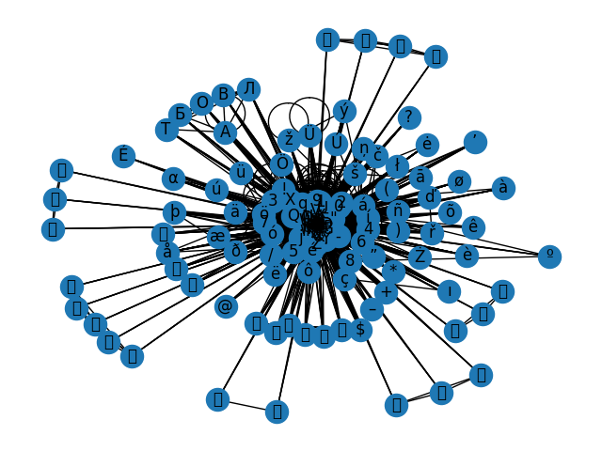
Artists Similarity Based Recommender (Graph Based)
Visualize Graph Network
undirected graph where nodes represent artists, and edges between nodes represent collaborations between those artists on songs.

Slide 22
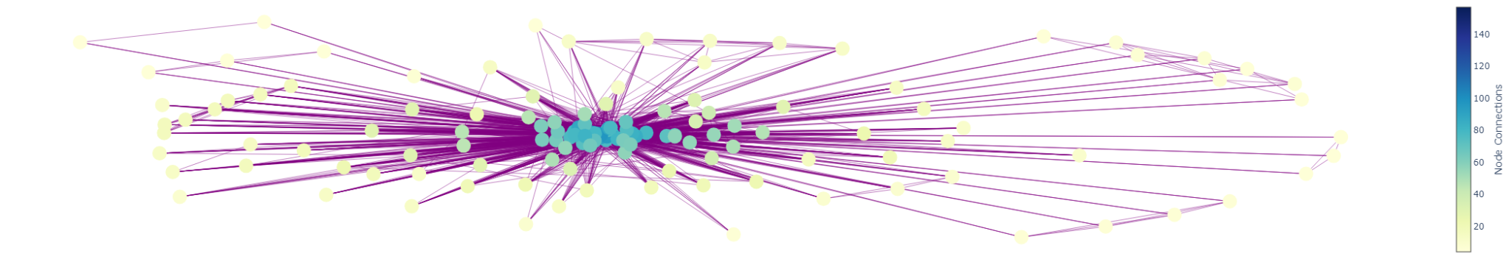
Artists Similarity Based Recommender (Graph Based)
Visualize Graph Network
undirected graph where nodes represent artists, and edges between nodes represent collaborations between those artists on songs.

Slide 23
Alternating Least Squares Recommender
Alternating Least Squares :
It is a collaborative filtering algorithm used for matrix factorization. Collaborative filtering is a technique that makes automatic predictions (filtering) about the preferences of a user by collecting preferences from many users (collaborating).
User-Item Matrix:
The features for the collaborative filtering model are selected, and a user-item matrix is created using the Compressed Sparse Row (CSR) matrix representation.
ALS Model Initialization and Training:
An ALS model is created with specified parameters such as the number of factors, regularization, and iterations.
The model is trained on the user-item matrix using the fit method.
Model Serialization (Saving and Loading):
The trained ALS model is saved to a file named 'als_model.pkl' using the pickle module.
The saved model is then loaded back from the pickle file.
Factor Matrices:
The user and item factors matrices are extracted from the loaded ALS model, and their shapes are printed.
Recommendation Function:
The function get_recommendations takes a track name, the ALS model, the song dataset (song_data), and an optional parameter for the number of recommendations.
It calculates the dot product between the user vector of the specified track and the item factors matrix.
The indices of tracks with the highest scores are obtained.
Redundant and same-name tracks are filtered out, and a list of recommended track names is returned.

Slide 24
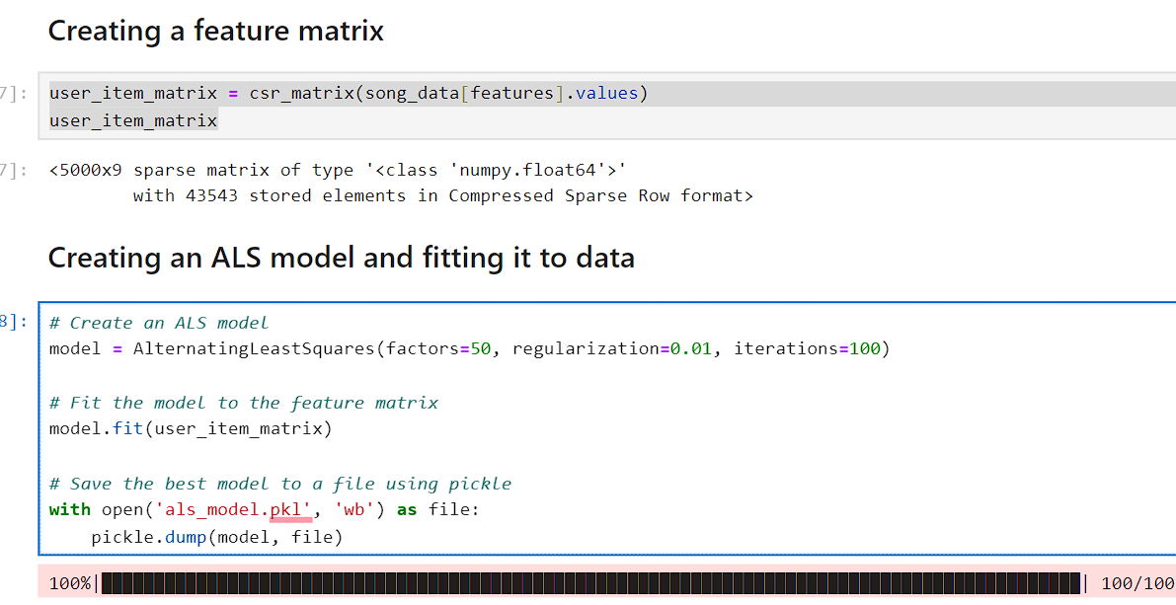
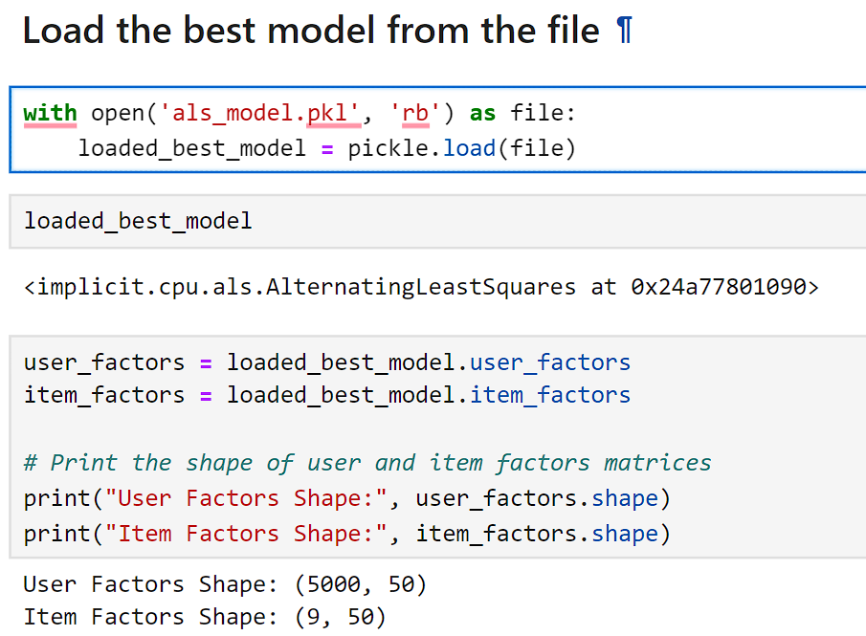
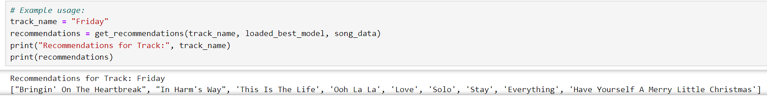
Alternating Least Squares Recommender

Slide 25
Web App File Structure
Music Recommendation System
├──── app.py
├──── content_renderer.py
├──── data
│ ├──── als_model.pkl
│ ├──── graph_data.pkl
│ ├──── lyrics_similarity.pkl
│ ├──── musical_feature_similarity.pkl
│ ├──── songs.csv
│ └──── song_data.pkl
├──── music.py
├──── path.py
├──── poster_maker.py
├──── Recommendation_System.ipynb
├──── recommenders
│ ├──── als_recommenders.py
│ ├──── artists_similarity_recommenders.py
│ ├──── collaborative_recommenders.py
│ ├──── lyrics_similarity_recommenders.py
│ └──── musical_similarity_recommenders.py
└──── signature.py

Slide 26
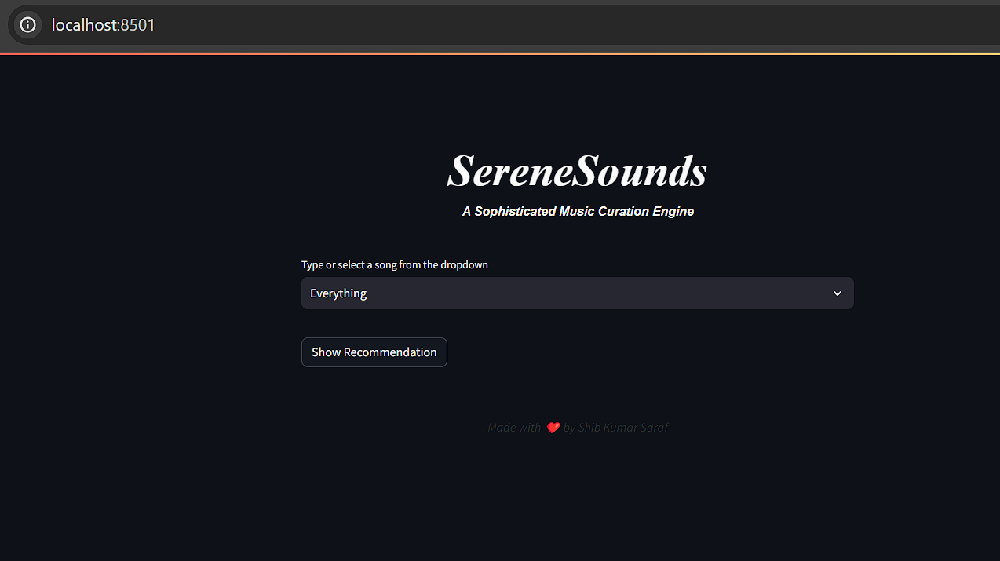
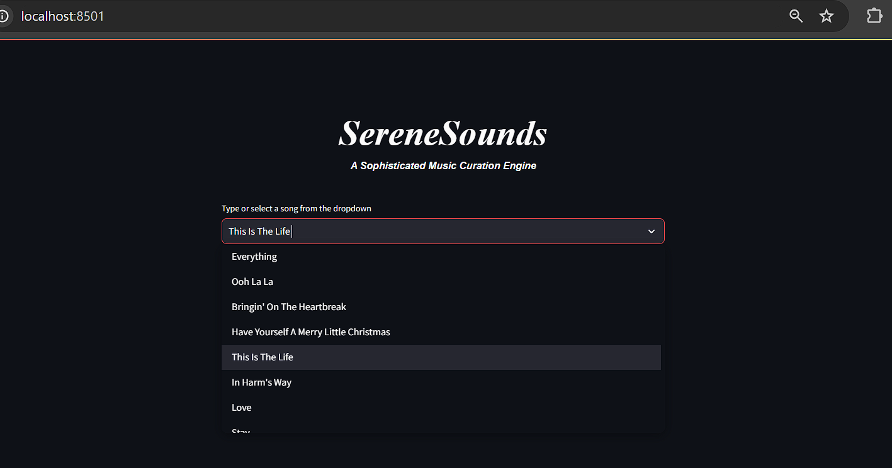
Web App Screenshots
Home Page
Choose song from Dropdown Menu

Slide 27
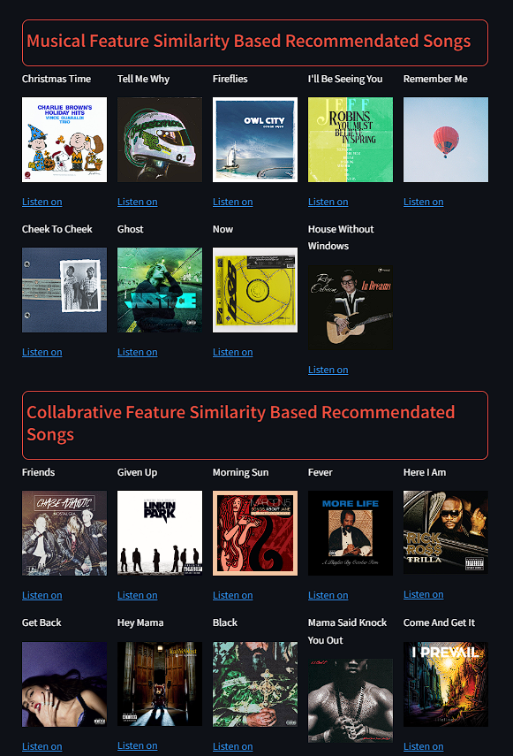
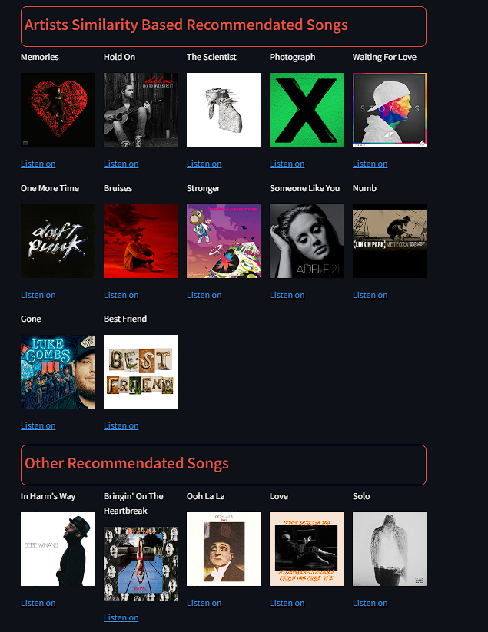
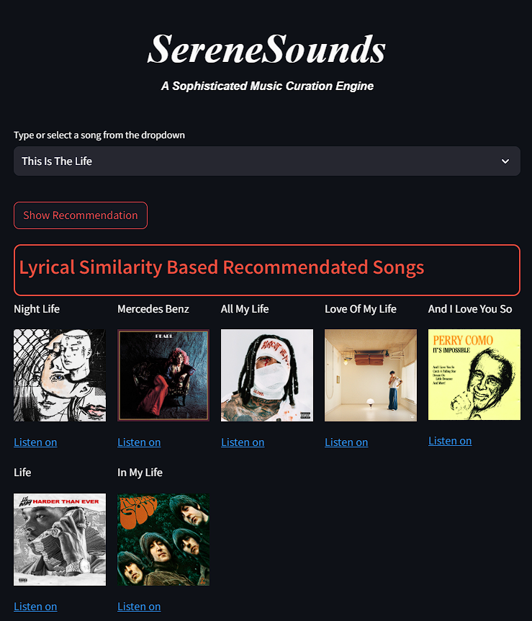
Web App Screenshots
Showing the recommedated song in various category wih music posters and links

Slide 28
THANK
YOU …

